Slide 1


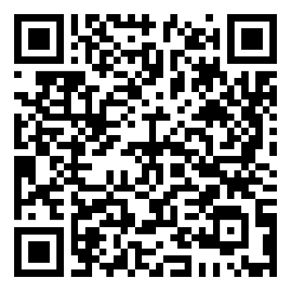
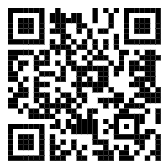


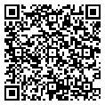

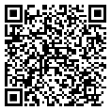
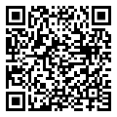



Sustainable waste separation
Hotel's public areas: Please kindly separate your waste. Waste collection bins are equally distributed by type to ensure that wherever there is a general waste bin, there is also a recycling station.
Guest rooms: Please use the room bins only for mixed/general waste and please kindly place your recycling waste to the side of the bins or dispose in the recycling bins located throughout the hotel's public areas.
Welcome to Labranda Club Makadi!
We wish you a pleasant stay with us.
MUST-KNOWS FOR YOUR STAY
FOR YOUR CONVENIENCE
Reception
The reception is open 24 hours a day. Our reception team will gladly provide you with information about dining, spa and wellness, activities and/or arrangement related to your stay.
To call reception, please dial 77.
Wi-Fi
Wi-Fi is complimentary and available in the Lobby and on the Terrace. Please log-in using the details below:
Room Number: ****
Last Name: ****
E-Mail address: ****
Check-out
Check-out time is 12:00. If you would like to request for a late check-out, please contact our reception for the availability and applicable charges.
Menus A La Carte Restaurants
Reservation A La Carte Restaurant
STAY IN TOUCH WITH US
Labranda club Makadi labranda_club_makadi
https://www.labranda.com/club-makadi
Bewerten Sie uns bei
Scan to access the full
Guest Directory Service

Slide 2

Lobby Bar
Soft, hot & alcoholic beverages
from 10:00 till 00:00
from 00:00 till 10:00 beverages against charge
pastry from 11am till 22:00
Blue moon Bar
From 17:00 till 23:00
Pool bar
10:00 – 17:00
Beach bar (Blue Wave)
from 10:00 – 17:00
“Blue Sky” Beach Restaurant
Breakfast buffet 7:00 - 10:00
Lunch buffet 12:30 - 15:00
“Otantik” Main Restaurant
Dinner buffet 18:30 – 21:30
Eat & Go
late breakfast 10:00 - 11:00
Snacks from 11:00 till 12:30 & from15:00 till 17:00
Tagine Restaurant
Late dinner 21:30 - 00:00
Early breakfast from 00:00 - 6:00
Late Lunch 16:00 - 18:00 only for late arrival
Del mare &Coco loco&Coral beach&Steak House& Ras El Naga(extra charge)
from 18 :30 till 21:30 (reservation required)
Restaurants and bars operating hours may vary depending on seasonality ,hotel occupancy, weather condition&themes nights
Specialty Restaurants (Promenade)
Reservations required
18:30 - 21:30
Italian : La mamma
Greek : Taverna Syrtaki
Taj Mahal : Indian restaurant
Asian : Red Dragon
Burger : Texas Burge
Oriental:Cairo Café
and tea/coffee & shisha(shisha for extra charge)from 15:00 till 22:00
French : Wine House Sushi Bar : Benzai
Shawerma World :
Arabic ( breakfast & Dinner ) Tagine
Ice Cream Giradino Delle Rose (Extra charge)
from 15:00 till 22:00
Specialty Restaurants reservations
Please make your reservation at the Guest relation Desk
between 09:00 - 14:00 (limited seats)
Evening Entertainment at Roman Theater
Mini Disco at 20:30
Animation Show at 21:00
Minibar (extra charge)
مكونات المينى بار بتكلفة إضافية
(price list available on top of minibar)
Daily one bottle of water free of charge.
Tea & coffee station is being refilled daily free of charge unless the “Do Not Disturb“ sign is hanged on the door.
Dresscode & Restaurant Rules
Dinner a la Carte
Men are required to wear trousers, decent shirts
or polo’s & closed shoes.
Women are required to wear dinner dress or equivalent attire.
The main restaurant is the only restaurant where
some flexibility is accepted.
Al Mastaba (shisha Corner; extra charge)
18:00 – 22:00
Breakfast & Lunch
Shorts, sandals and beach/swimming wear are allowed if worn with appropriate tops or light summer dress.
Management will always advise guests of the dress code regulations when needed and expect cooperation in order to maintain the standards of quality in the property.
Room Service (extra charge)
Dial ext. 5204 24 hours
Continental Breakfast & Lunch Boxes
Please make your order in advance till maximum 20:00 one day before at the reception desk
Beach towels
In case of lost beach towels or towel cards, a fee of 15 Euro will be charged.
Changing beach towels at the Beach from 07:00 until Sunset
It is not allowed to hang clothes or towels on the Balcony.
Swimming Pool Dress Code
Proper swimming wear is required; for your health and hygiene. It is prohibited to wear full body
swimming dresses & T-shirts.
Gym & Activities
Our Gym is opened from 07:00 - 19:00 located at the beach
Tennis (30 min/day free of charge) (reservation at the beach)
El Clasico (Sportsbar)
From 10:00 – 00:00
From 14:00 – 00:00 (Bar)
ALL INCLUSIVE
RESORT INFORMATION
LABRANDA Club Makadi
Hurghada - Red Sea - Egypt
P.O. Box 341
Tel: 0020 65 3590319-24
Email: guestrelation.club@mphotelseg.com
GENERAL INFORMATION
Reception 77
Emergency 77
Operator 77
Guest Relations 5858
Whats-app / Telegram +201062168333
CHECK IN: 15:00 CHECK OUT: 12:00 NOON
Guest Relations
Guest Relations desk is located next to the reception desk .
Safety Deposit Boxes
Safety deposit boxes are provided without charge in the rooms. The hotel management takes no
responsibility for any valuables left in guest rooms.
Hotel Doctor (against charge)
The hotel doctor is 24h a day available for
emergency cases through the reception desk.
Internet
WIFI internet is for free in the Lobby and on the Terrace
All inclusive concept
10:00 till 00:00

